Slide 1
Aerodynamics in F1 and formula student
Jonas Pangerl
Aerodynamicist
Williams Racing

Slide 2
CONTENTS
FUNDAMENTALS
FORMULA 1 AERODYNAMIC DEVELOPMENT
UNDERSTANDING DEVELOPMENT METRICS
HOW TO IMPROVE YOUR DEVELOPMENT PROCESS
COMMON FORMULA STUDENT MISTAKES

Slide 3
About me
University: UAS Esslingen
Formula Student (Sub-team Aerodynamics and CFD) from 2017-2021
Master Thesis at Williams Racing about high fidelity CFD simulations
Engineering Design Judge at FS East 2022
Aerodynamicist at Williams Racing

Slide 4
Fundamentals

Slide 5
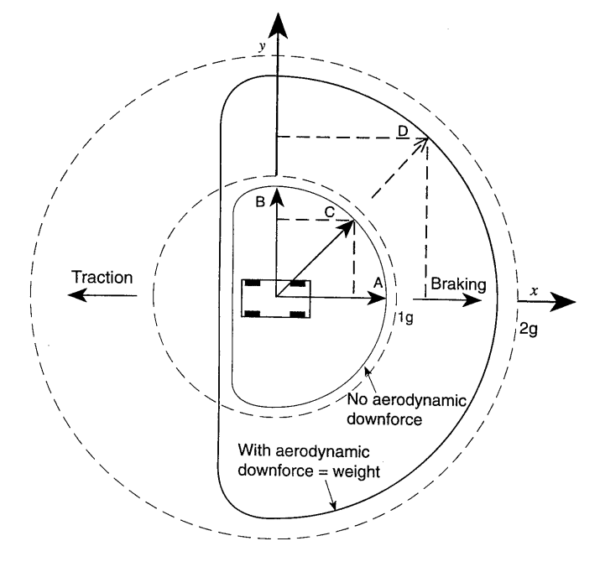
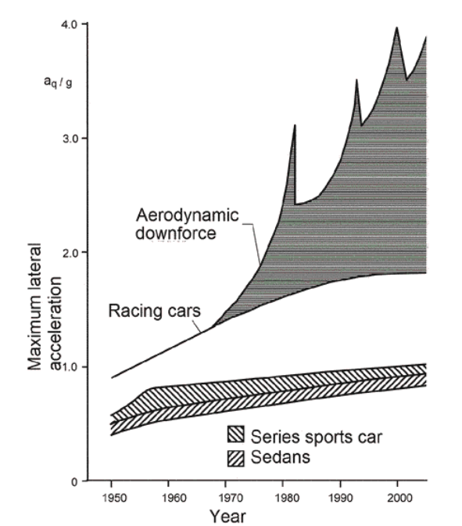
Laptime improvements through Aerodynamics
Katz, Joseph. (1995). Race Car Aerodynamics: Designing for Speed
Schuetz, Thomas. (2016). Aerodynamics of Road Vehicles (5th Edition)

Slide 6
Aerodynamic coefficients
Why coefficients?
Normalization of variables
Compare different driving speeds
Compare different dimensions of the car (WT and full size)
Lift: C_{L}
Drag: C_{D}
Static pressure: C_{p}
Total pressure (energy): total C_{p} → C_{p}T

Slide 7
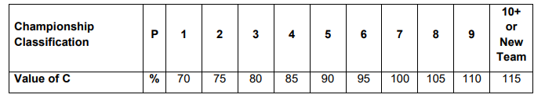
Aerodynamic Testing Restrictions in F1
Defined in the FIA Formula 1 Sporting Regulations
Goal: limit development time, balance performance between teams, limit costs
CFD
RATG: restricted aerodynamic test geometry → limits number of different geometries to be simulated
MAUh: Mega Allocation Unit hours → limits solving effort over all RATGs
Wind tunnel
Runs → limits number of wind tunnel runs
Wind On Time → limits time where tunnel airspeed is above 5 m/s
Occupancy → limits working time in/around the tunnel
Track
Testing to take place only in official Free Practice sessions
Requires high efficient simulations
FIA 2022 Formula 1 Sporting Regulations

Slide 8
Formula 1 aerodynamic development

Slide 9
Development path
Regulations
Idea generation
CFD development
Wind tunnel testing
Track testing
Aero testing restrictions (ATR)

Slide 10
Idea Generation
Flow field targets
Onset CpT and wake management
Yaw and ride height characteristics
Cooling performance
Load distribution
Geometry comes from aero perspective

Slide 11
CFD
CFD is first design tool
Allows a deep insight in flow field
Quick turnaround times
Balancing between accuracy and efficiency (RANS, DES, …)
Automated investigation available (Adjoint solver, …)
Run limited number of conditions
→ Be aware of limitations!

Slide 12
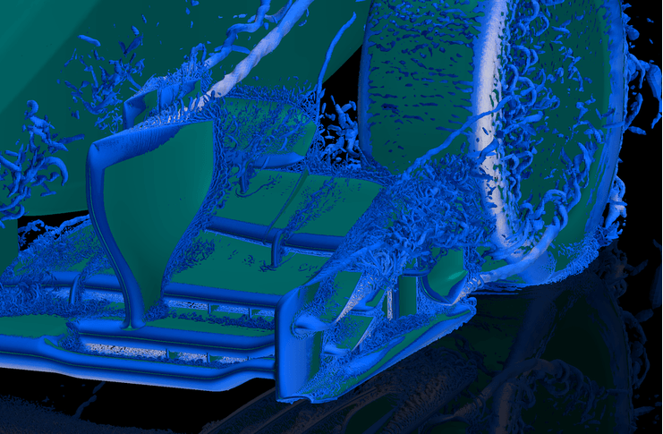
Transient CFD
Resolves transient effects
More accurate but computationally expensive
Understand where it is needed and how you can use the data
Wall resolved Large-Eddy-Simulation

Slide 13
Wind Tunnel Testing
Physical aerodynamics testing at scale
External aerodynamics modelling
Regulated by ATR
Develop a stable and predictable car
Fewer options for detailed analysis
Compromised cornering simulation compared to CFD and track

Slide 14
Wind tunnel testing
Off-surface flow field data:
Particle Image Velocitimetry (PIV)
Rakes
Kiel probes

Slide 15
Wind tunnel testing
Off-surface flow field data:
Particle Image Velocitimetry (PIV)
Rakes
Kiel probes
On-surface flow field data:
Pressure tappings
Flow Viz
Wool Tufts

Slide 16
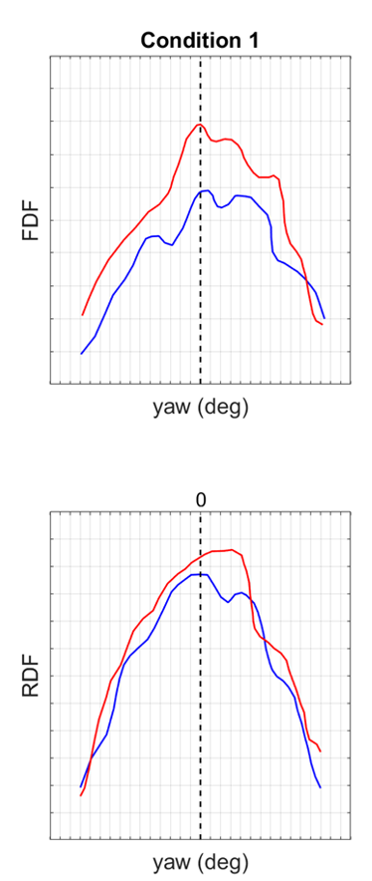
Wind Tunnel Testing
Develop a stable and predictable car:
Smooth sweeps, remove peaks
Performance where you want to set-up the car (high rake vs low rake)
Understand where structures break down, flow separates, …
BASELINE
OPTION

Slide 17
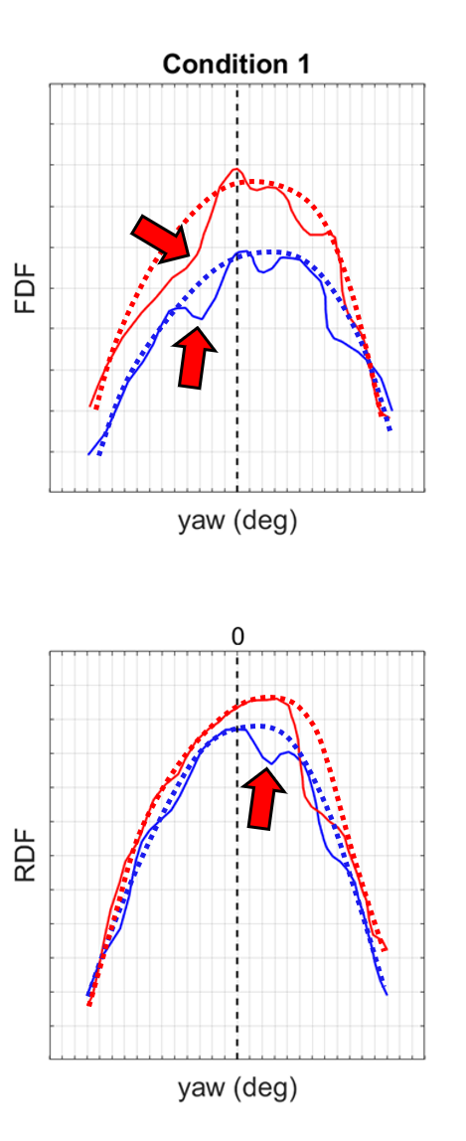
Wind Tunnel Testing
Develop a stable and predictable car:
Smooth sweeps, remove peaks
Performance where you want to set-up the car (high rake vs low rake)
Understand where structures break down, flow separates, …
BASELINE
OPTION

Slide 18
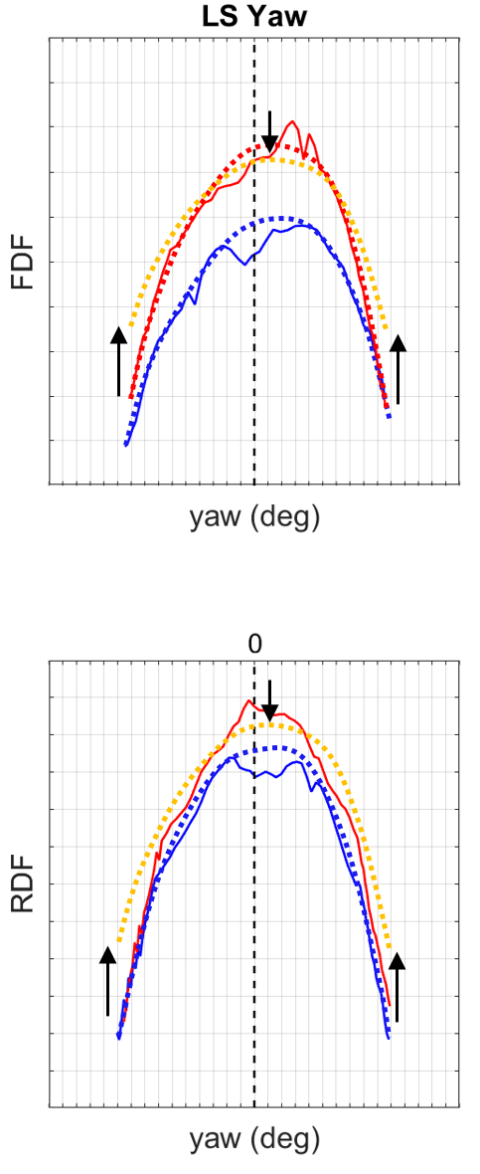
Wind Tunnel Testing
Develop a stable and predictable car:
Smooth sweeps, remove peaks
Performance where you want to set-up the car (high rake vs low rake)
Understand where structures break down, flow separates, …
BASELINE
OPTION

Slide 19
Track Testing
Real world testing
Driver feedback
Unstable and noisy conditions
Less data
Limited time

Slide 20
Understanding development metrics

Slide 21
Front wing Polar
Front Wing Flap (FWF) to adjust aerodynamic balance between front and rear axle
High FWF
Total DF
Mid FWF
Low FWF
RWDs AB
AeroBal
FWDs AB

Slide 22
Front wing Polar
Front Wing Flap (FWF) to adjust aerodynamic balance between front and rear axle
Development options need to be „above“ polar to improve overall performance
Otherwise we could just crank up the FWF to get the same aero balance and also more downforce
Consider new behaviour over FWF angles
“above polar”
Dev 1
Dev 1
High FWF
Dev 2
Dev 2
Total DF
Mid FWF
“below polar”
Low FWF
RWDs AB
AeroBal
FWDs AB

Slide 23
Front wing Polar
“above polar”
Dev 3
High FWF
Total DF
Mid FWF
“below polar”
Low FWF
RWDs AB
AeroBal
FWDs AB

Slide 24
Rear Wing Polar
Different rear wings to select the right drag level for the given circuit
Development options (not only rear wings) need to beat polar to provide an overall benefit
(Gurney)
High DF
Dev 1
(Gurney)
Total DF
Mid DF
Dev 2
Low DF
(Gurney)
Drag

Slide 25
Rebalancing and Redragging
Balance and aerodynamic efficiency must be considered in development
Approximate linear downforce/balance ratio from FW polar
Approximate linear downforce/drag ratio from RW polar
Calculate „headline“ number with total downforce and ratios to get an overall number that indicates the performance benefit

Slide 26
How to improve your development process

Slide 27
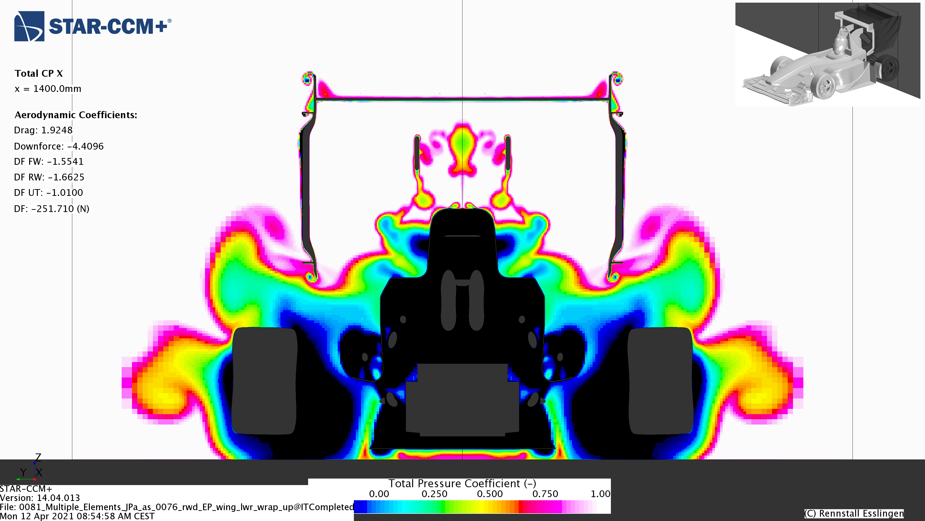
IDEA & Concept generation
Statement: “Most Formula Student cars lack a comprehensive flow field concept.”
Analyse your current concept:
Where could I improve onset CpT

Slide 28
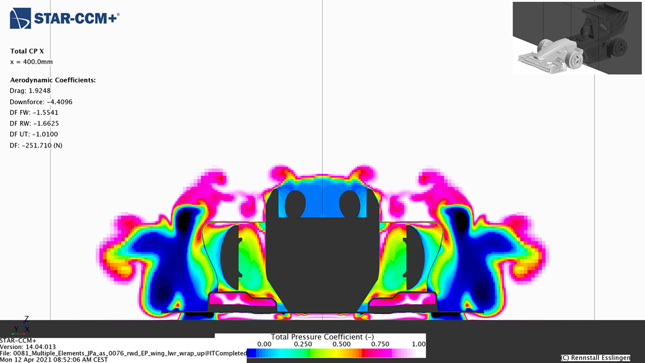
IDEA & Concept generation
Statement: “Most Formula Student cars lack a comprehensive flow field concept.”
Analyse your current concept:
Where could I improve onset CpT
How is the wheel wake management

Slide 29
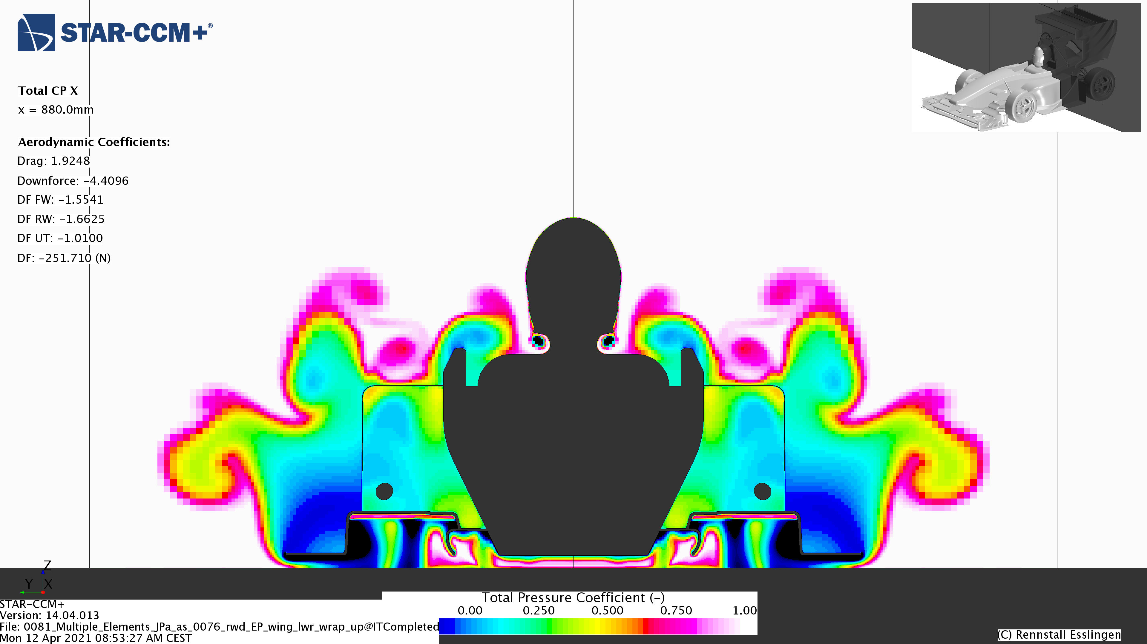
IDEA & Concept generation
Statement: “Most Formula Student cars lack a comprehensive flow field concept.”
Analyse your current concept:
Where could I improve onset CpT
How is the wheel wake management
Where do I need more “fresh” air

Slide 30
IDEA & Concept generation
Statement: “Most Formula Student cars lack a comprehensive flow field concept.”
Analyse your current concept:
Where could I improve onset CpT
How is the wheel wake management
Where do I need more “fresh” air
What happens in cornering/under yaw or at extreme ride heights
How could I improve my radiator performance
Where do I want to put my wasted air
Where could I have instabilities (vortex brake down, separation, …)
How could I improve the interaction between different components

Slide 31
IDEA & Concept generation
Statement: “Most Formula Student cars lack a comprehensive flow field concept.”
Analyse your current concept:
Where could I improve onset CpT
How is the wheel wake management
Where do I need more “fresh” air
What happens in cornering/under yaw or at extreme ride heights
How could I improve my radiator performance
Where do I want to put my wasted air
Where could I have instabilities (vortex brake down, separation, …)
How could I improve the interaction between different components
Decide on your flow field objectives
NOT: where could I put a wing to see what it does!

Slide 32
IDEA & Concept generation
Statement: “Most Formula Student cars lack a comprehensive flow field concept.”
Analyse your current concept:
Where could I improve onset CpT
How is the wheel wake management
Where do I need more “fresh” air
What happens in cornering/under yaw or at extreme ride heights
How could I improve my radiator performance
Where do I want to put my wasted air
Where could I have instabilities (vortex brake down, separation, …)
How could I improve the interaction between different components
Decide on your flow field objectives
Develop towards your target, do not focus on numbers at the beginning
Try different concepts, do not waste time with too much detailing
Decide for a concept and refine it

Slide 33
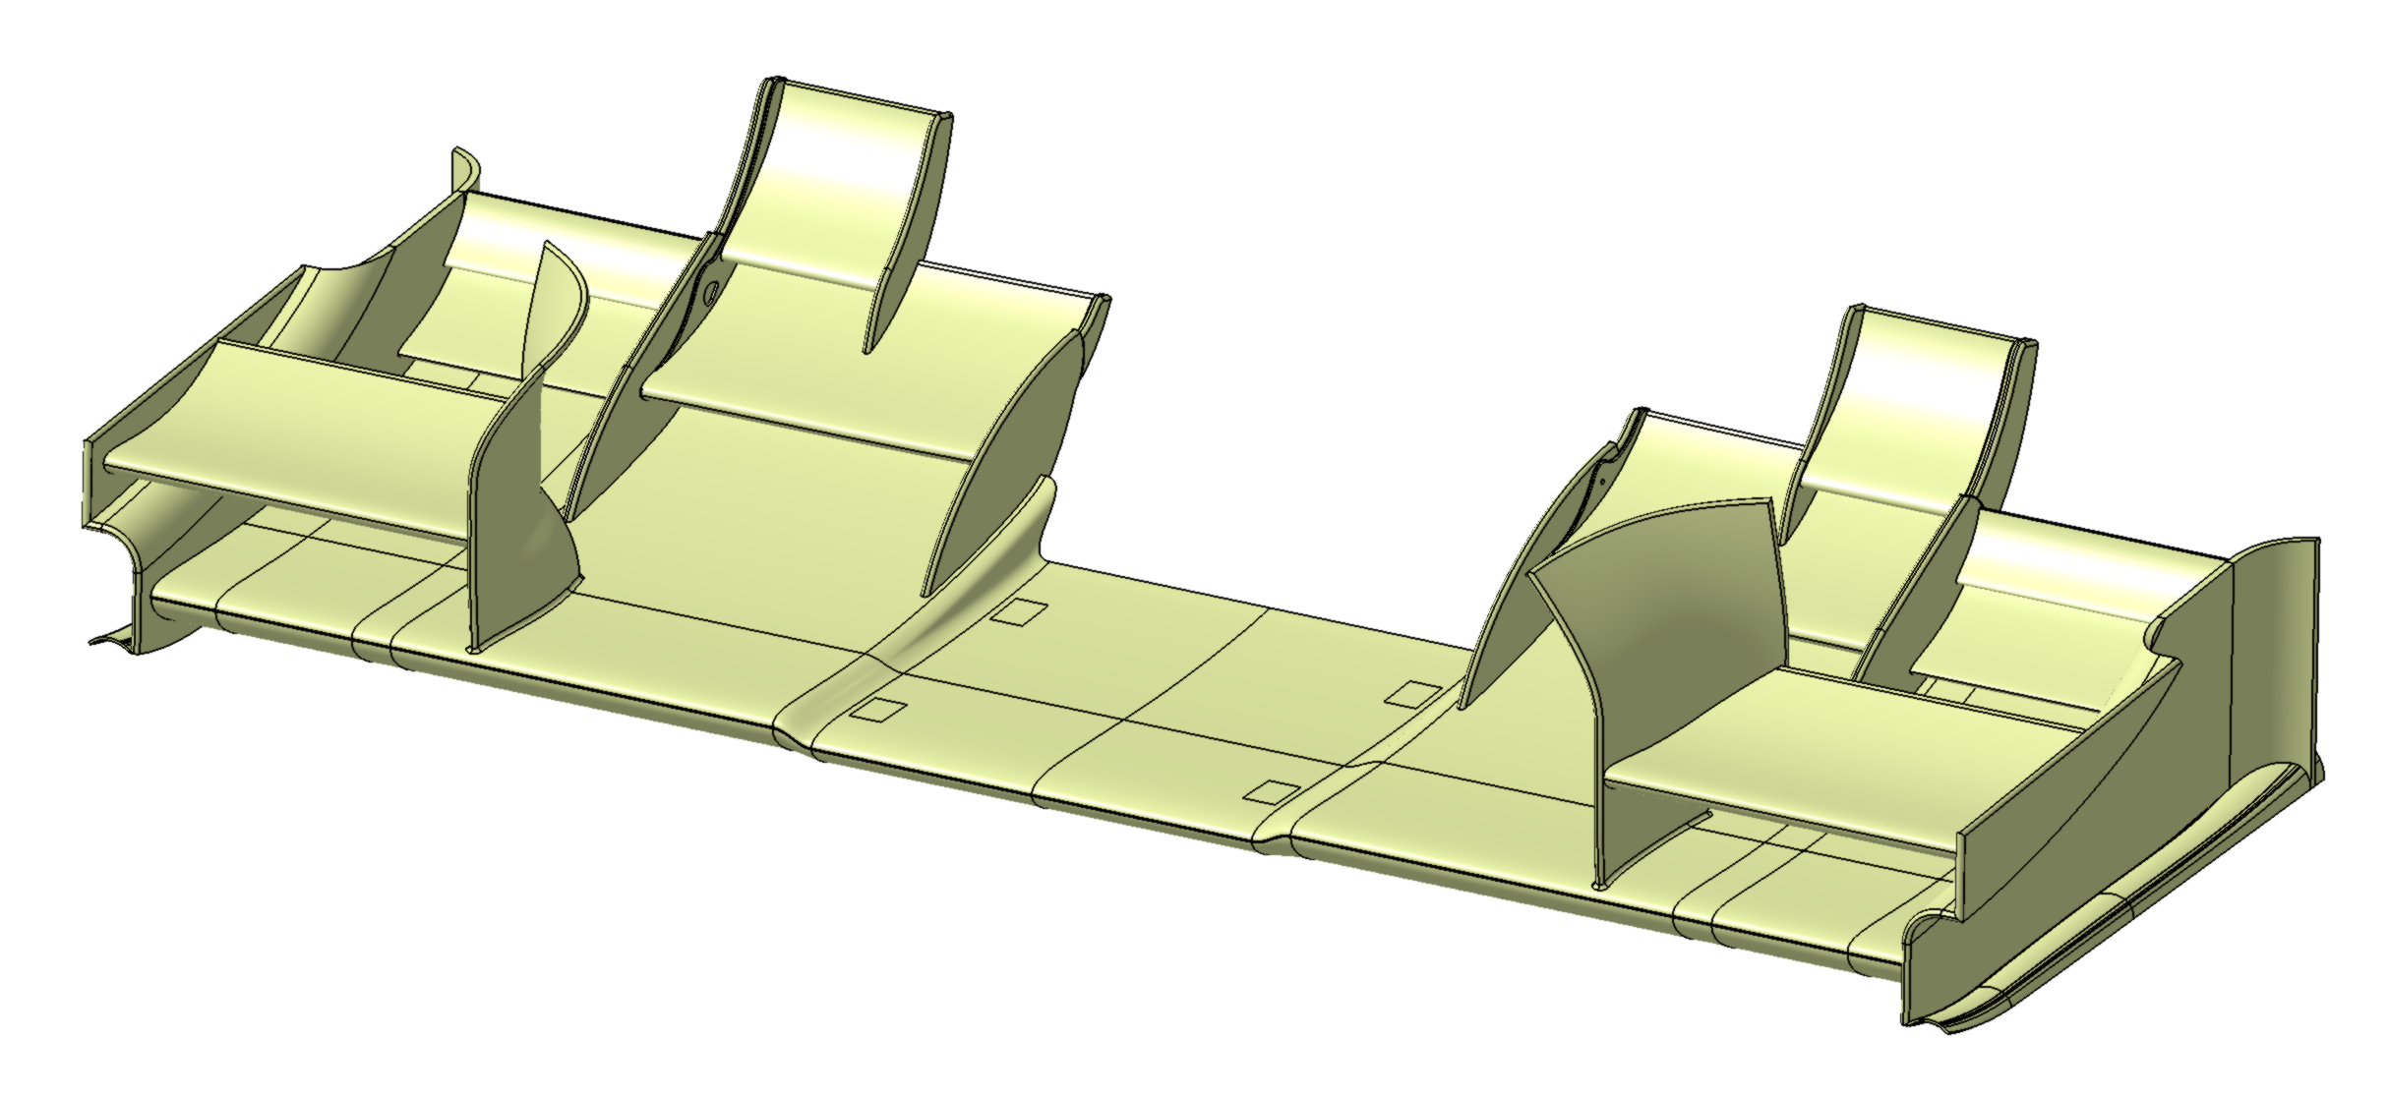
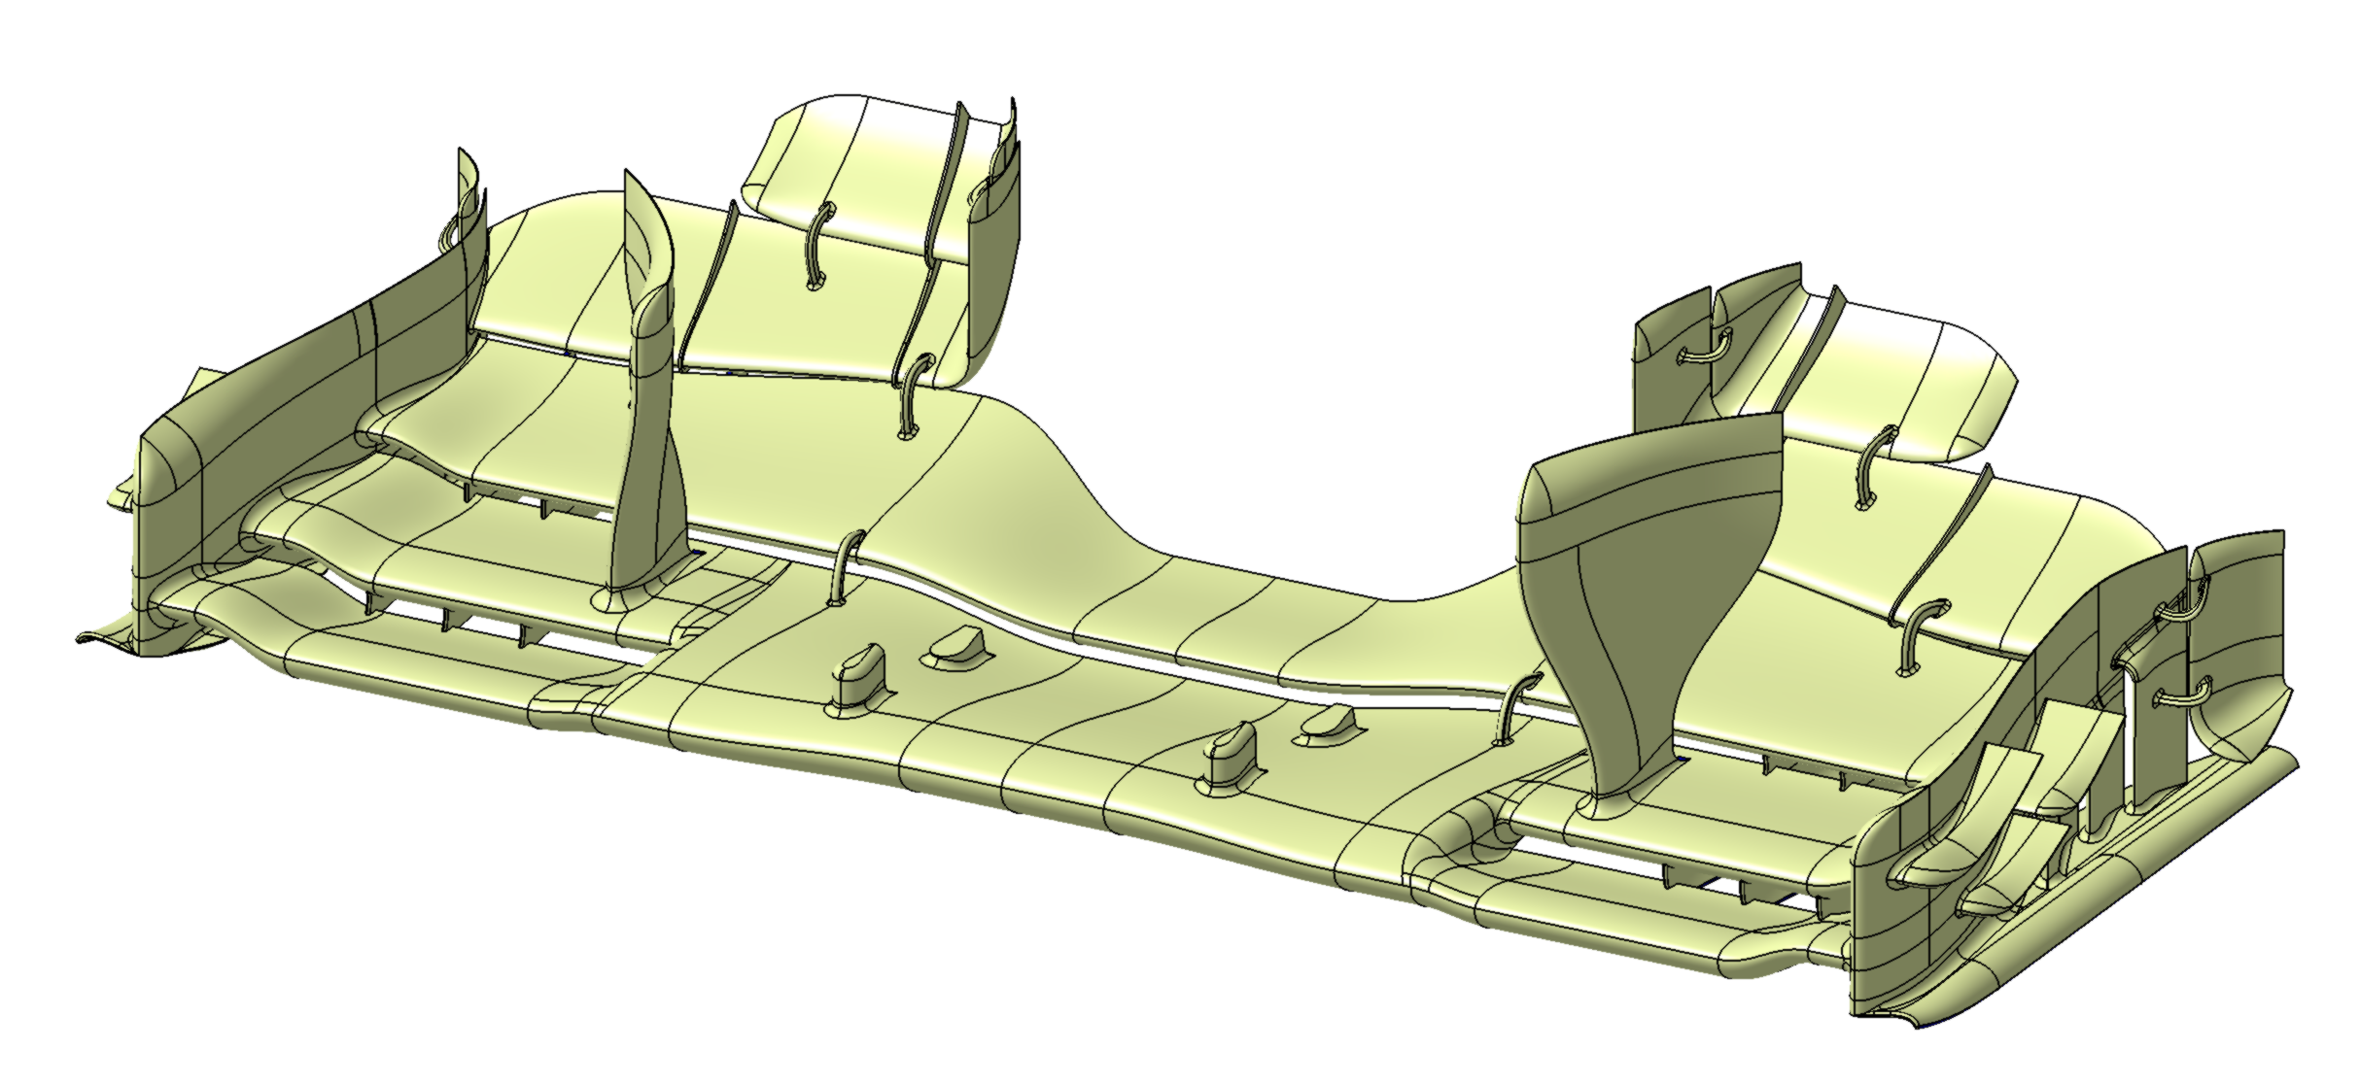
IDEA & Concept generation - EXAMPLE
Example Rennstall Front Wing development
Flow field objectives:
Improve onset CpT to rear
More continuous behaviour through yaw and ride height
More downforce
Adjustable aero balance
old wing
new wing

Slide 34
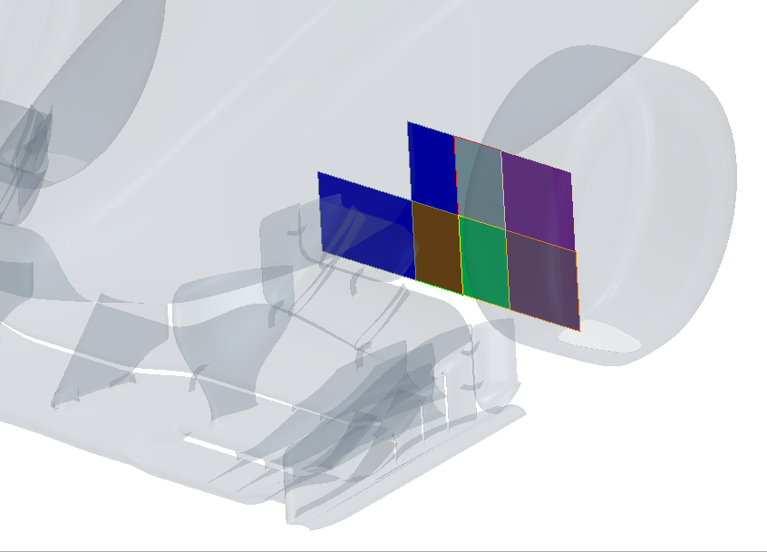
IDEA & Concept generation - EXAMPLE
old wing
new FW
old FW
new wing

Slide 35
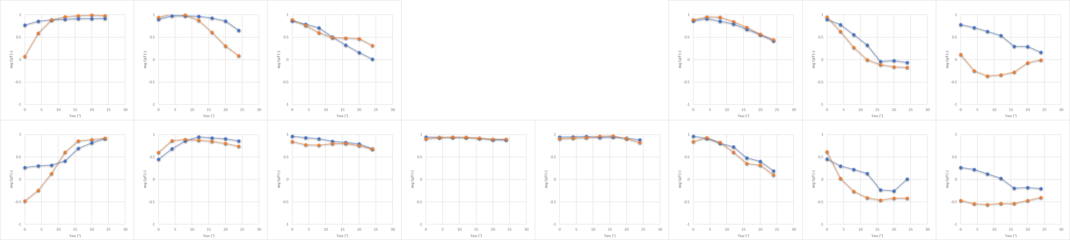
IDEA & Concept generation - EXAMPLE
new FW
old FW
leeward
windward
y=0

Slide 36
CAD and Airfoils

Slide 37
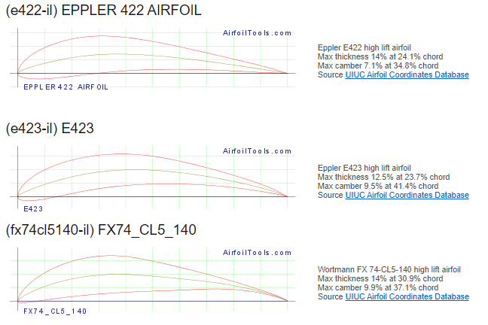

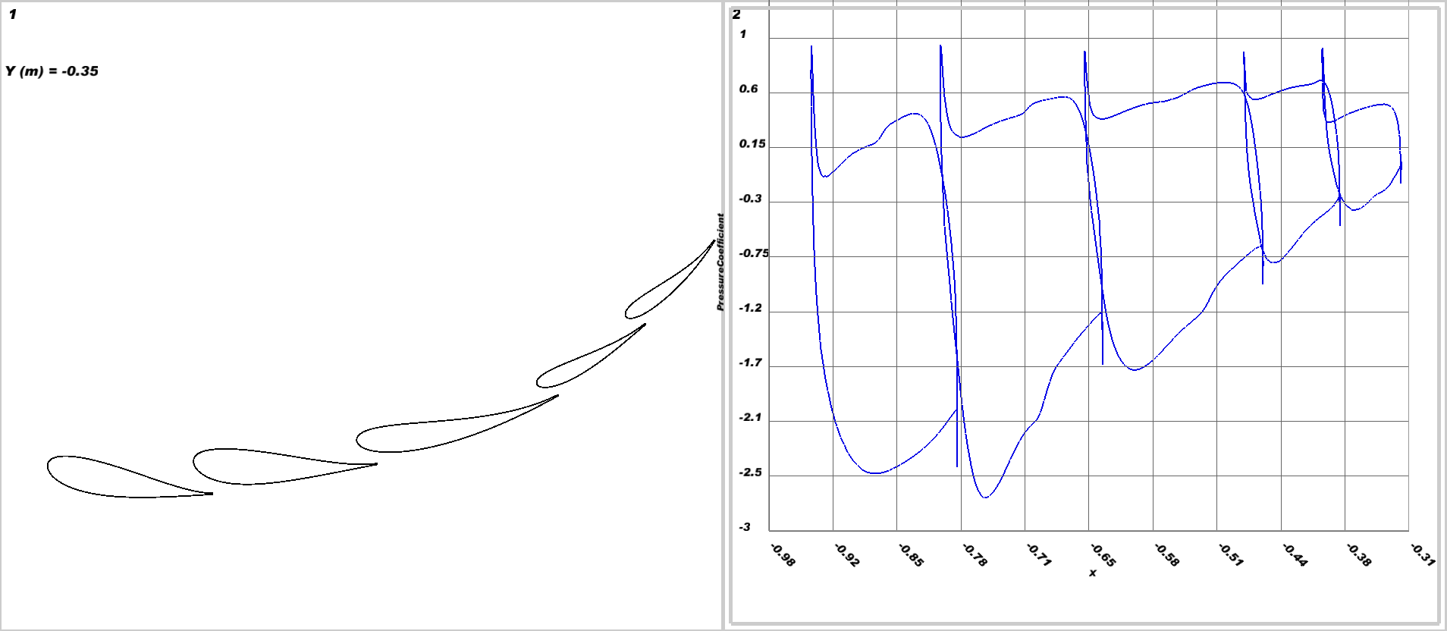
CAD
Create your own airfoils, do not use predefined ones

Slide 38
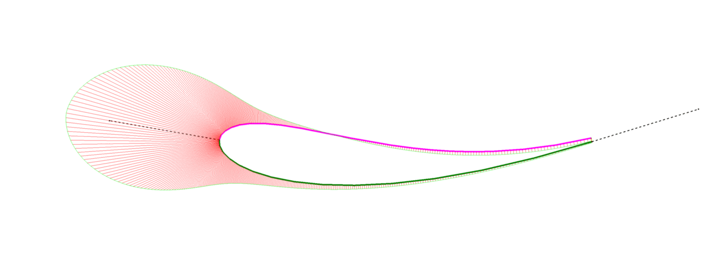
CAD
Create your own airfoils, do not use predefined ones
make the airfoils adjustable:
Onset angle
LE thickness
Curvature distribution
Departure angle
Keep an eye on curvature

Slide 39
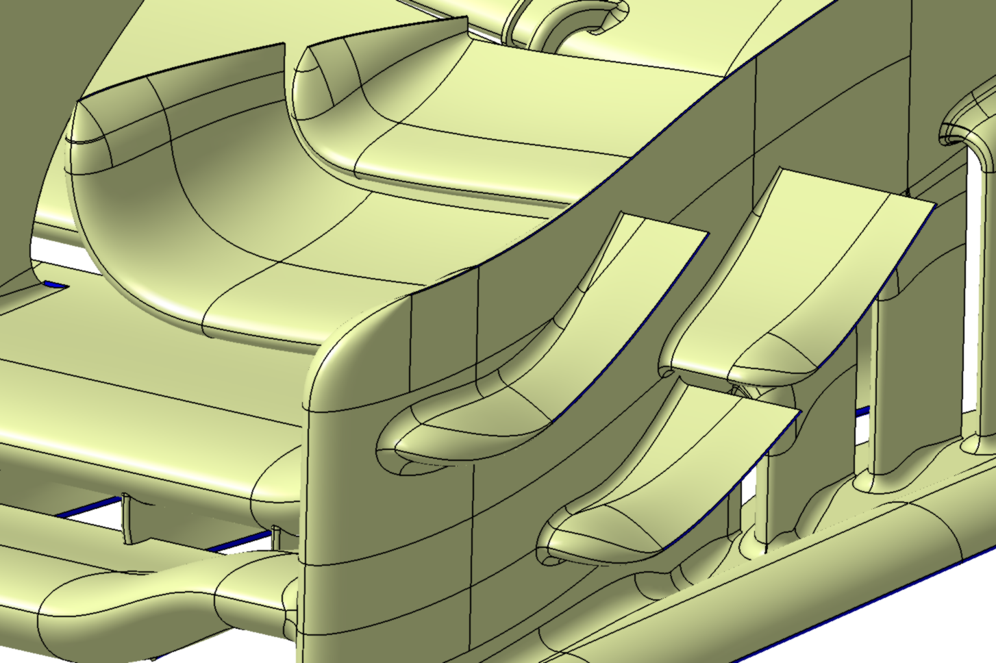
CAD
Create your own airfoils, do not use predefined ones
make the airfoils adjustable:
Onset angle
LE thickness
Curvature distribution
Departure angle
Keep an eye on curvature
Avoid sharp angles and transitions → use blends and fillets
Keep shedding edges sharp

Slide 40
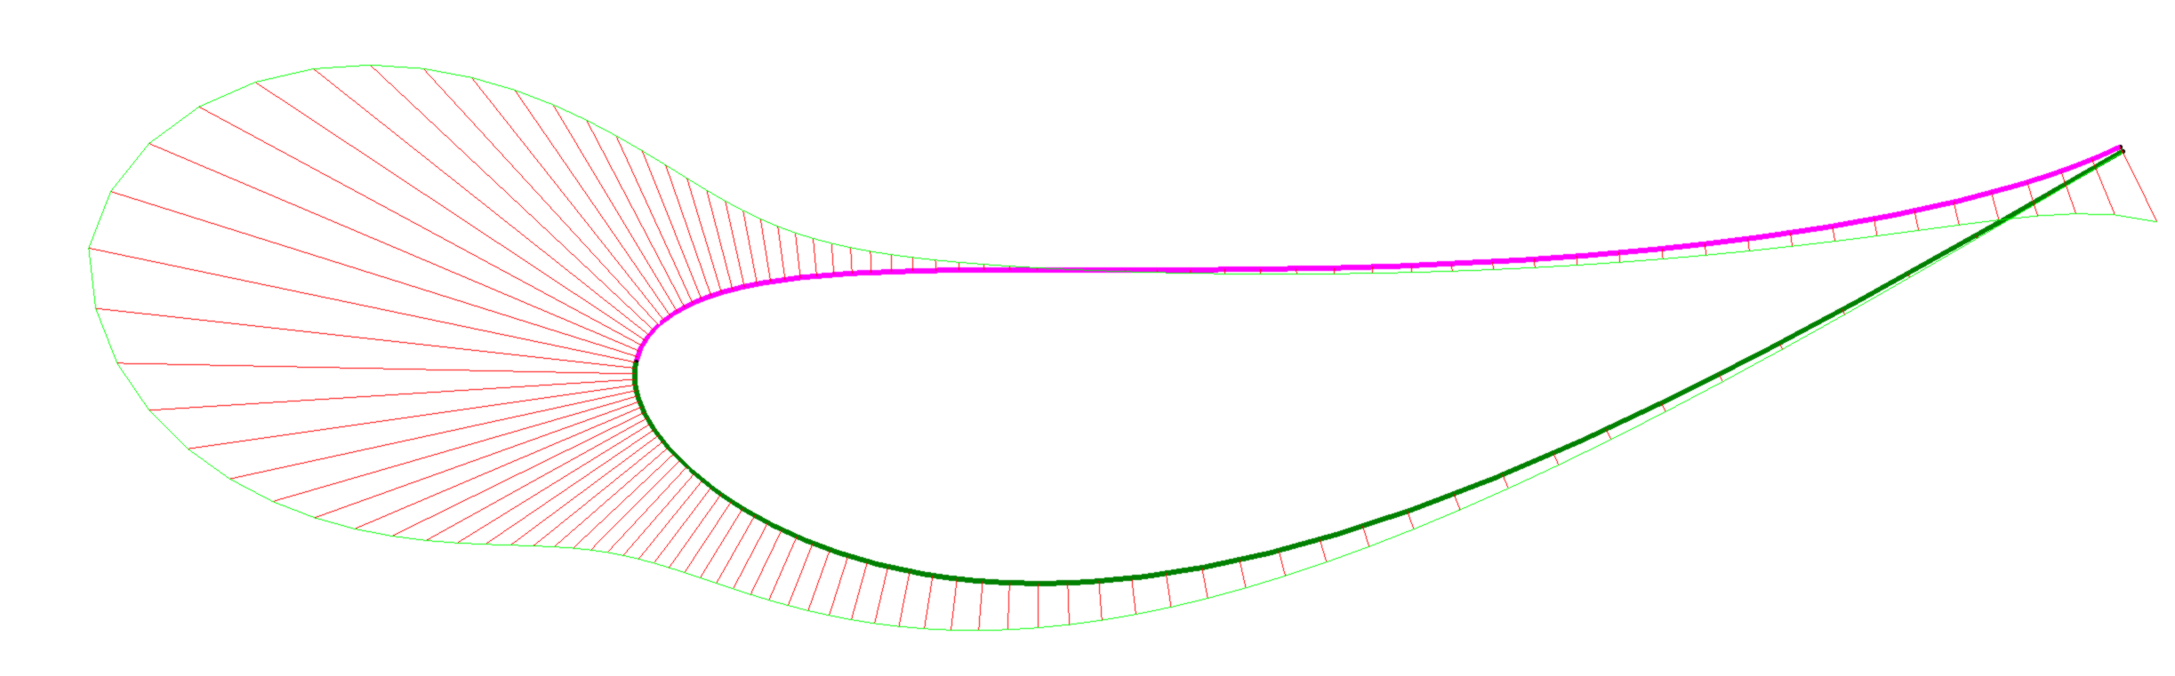
Airfoils
Onset Flow
Stagnation point on leading edge
Highest curvature on stagnation point
Curvature continuity between pressure and suction side
Increase leading edge radius (decrease curvature) in case of variable onset angles

Slide 41
Airfoils
Onset Flow
Stagnation point on leading edge
Highest curvature on stagnation point
Curvature continuity between pressure and suction side
Increase leading edge radius (decrease curvature) in case of variable onset angles

Slide 42
Airfoils
Departing Flow
Increase departure angle for higher load
Decrease angle to keep flow attached

Slide 43
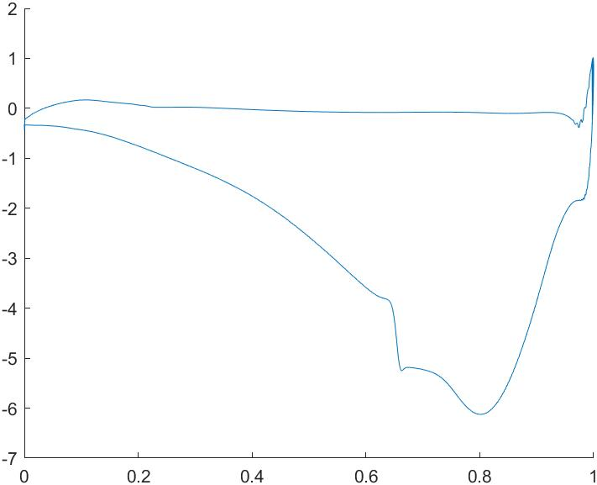
Airfoils
Pressure recovery region
Curvature distribution
Defines pressure distribution
Cp peak
Adverse pressure gradient (length & gradient of Cp recovery)
Drag and thrust components
Move curvature forwards to
Support upstream profiles
Reduce drag
Increase recovery length and gradient
Force transition
Cp
Re-attachement point
Suction peak
Laminar separation bubble

Slide 44


Airfoils
Pressure recovery region
Curvature distribution
Defines pressure distribution
Cp peak
Adverse pressure gradient (length & gradient of Cp recovery)
Drag and thrust components
Move curvature forwards to
Support upstream profiles
Reduce drag
Increase recovery length and gradient
Force transition
Equally distribute curvature to
Reduce boundary layer growth
Create maximum load
needs support from downstream geometry
Cp

Slide 45
Multi Element Wing Cascades
Why more elements?
Re-energize boundary layer on suction surface
Increase capability of flow turning
DRS implementation (rear wing)
Delay/avoid stall at low ride heights (front wing)
Why less elements?
More load
Less lossy departing flow
Easier to develop
Lighter

Slide 46
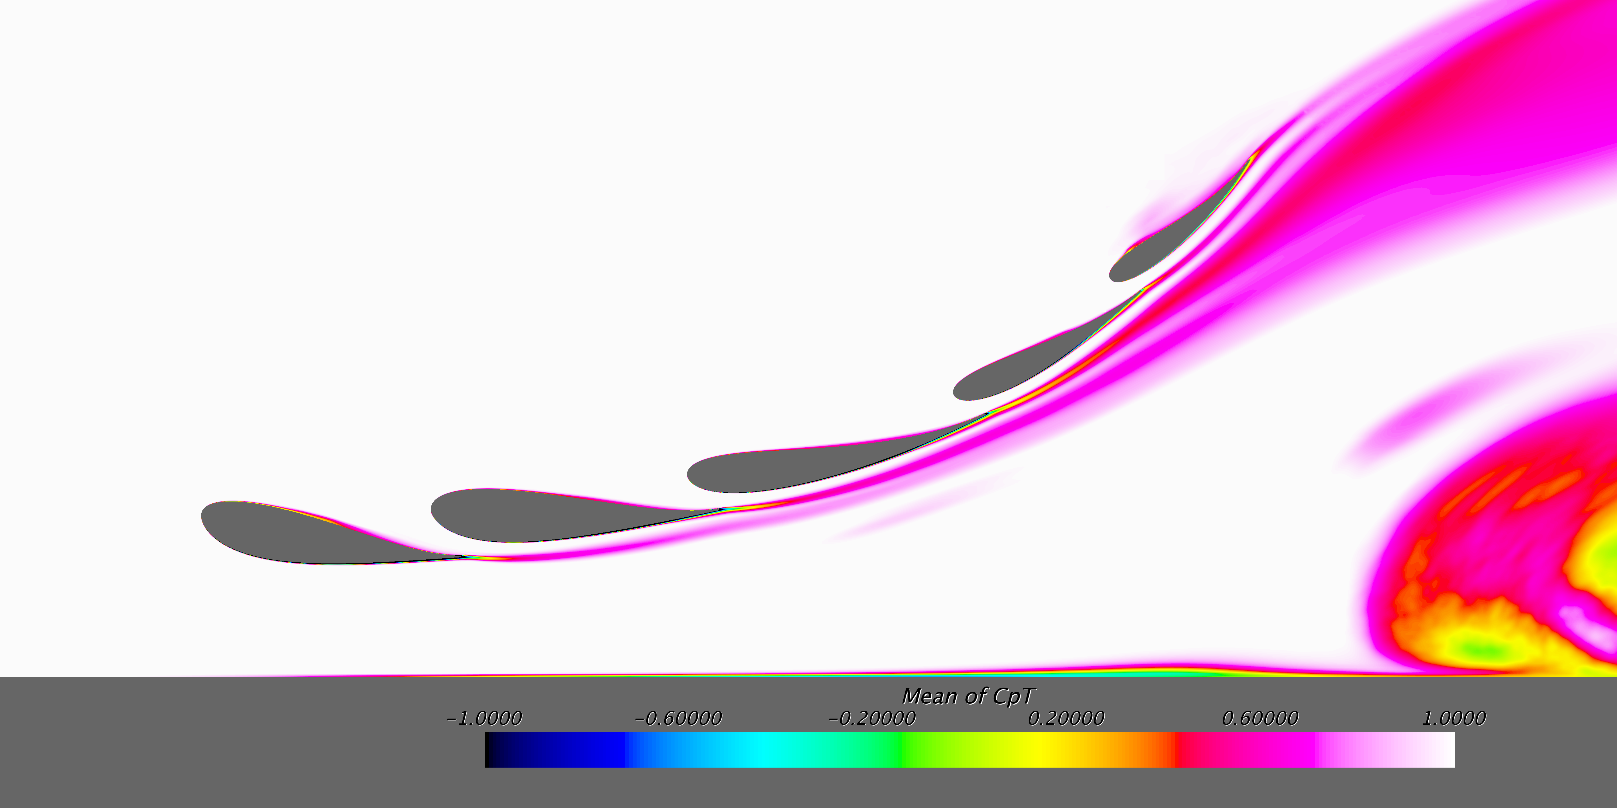
Multi Element Wing Cascades
Slot gaps
Allow high energy flow from pressure side to suction side
Decrease slot gap size to
Support upstream profile
Increase overall load
Increase slot gap size to
Allow more air going through
Support downstream profile

Slide 47
Multi Element Wing Cascades
Curvature
Avoid large Cp jumps between elements
Move curvature forward to support upstream element
Supported elements can have significant amount of trailing edge curvature

Slide 48
Multi Element Wing Cascades
Departure angle
Leave space for flow through slot gap
Increase departure angle to transfer load to forward element (offload upstream element)
Decrease departure angle to transfer load to downstream element

Slide 49
Multi Element Wing Cascades
Departure angle
Leave space for flow through slot gap
Increase departure angle to transfer load to forward element (offload upstream element)
Decrease departure angle to transfer load to downstream element

Slide 50
Multi Element Wing Cascades
Departure angle
Leave space for flow through slot gap
Increase departure angle to transfer load to forward element (offload upstream element)
Decrease departure angle to transfer load to downstream element

Slide 51
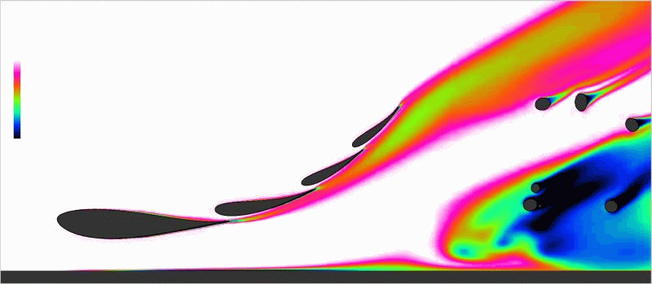
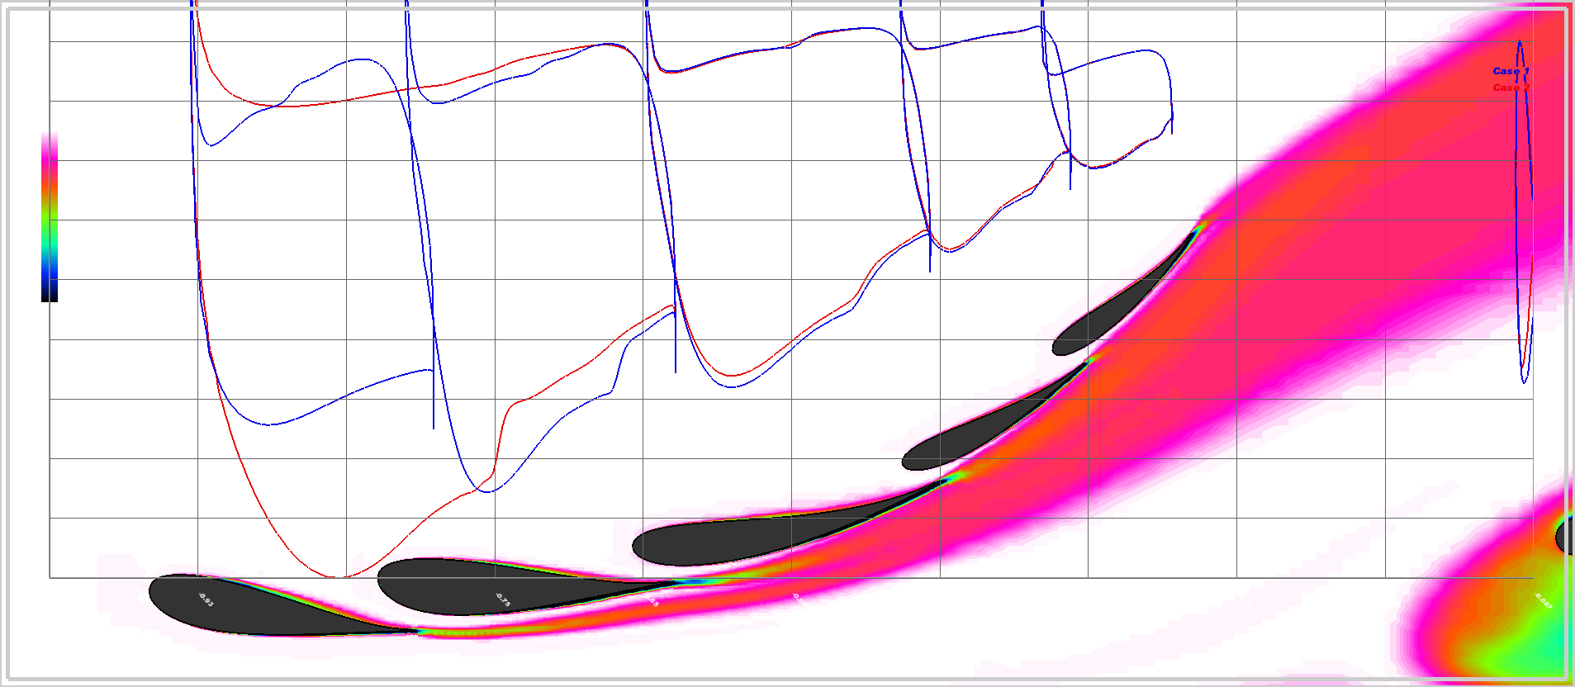
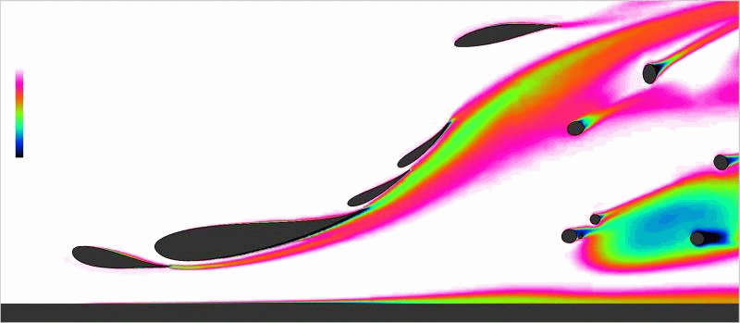
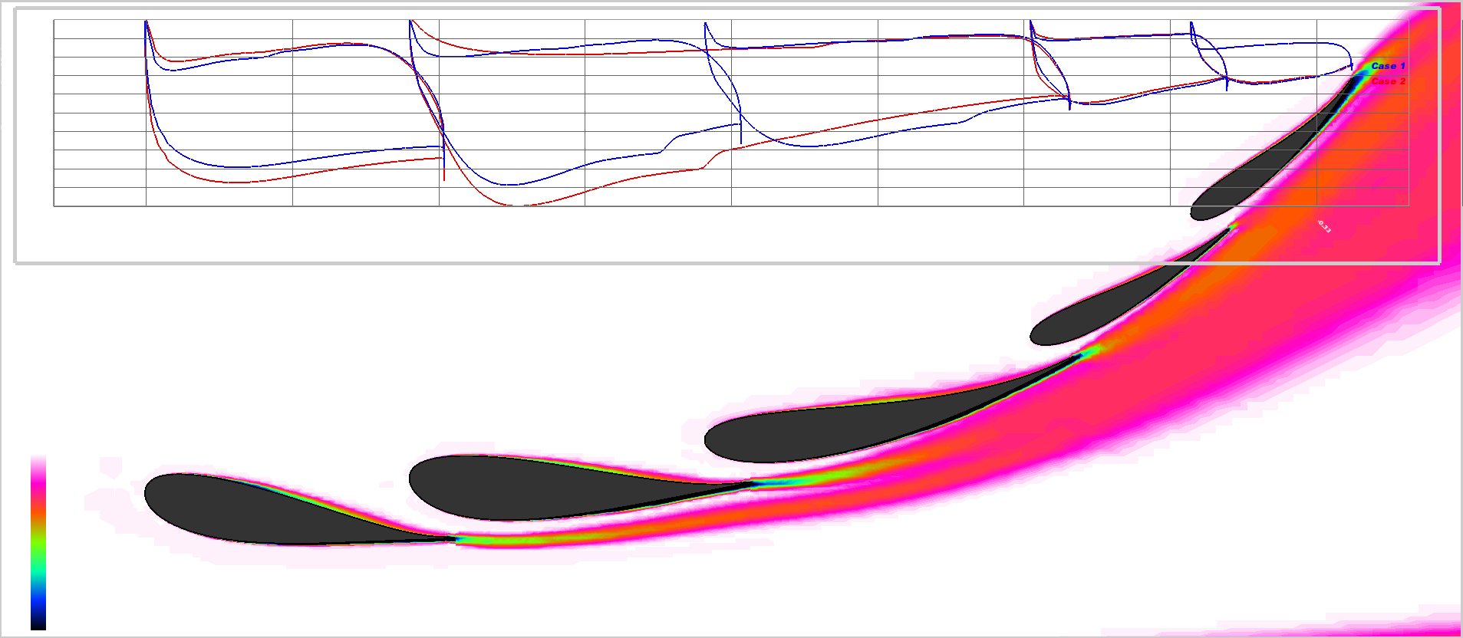

Muti Element Wing Cascades

Slide 52
Optimizing the CFD Process

Slide 53
Optimizing the CFD Process
Improving the Tool Kit
Improved simulation accuracy
Better utilisation of data
Quicker turnaround times

Slide 54
Optimizing the CFD Process
new cluster
smarter mesh
improve accuracy

Slide 55
Optimizing the CFD Process
Changed spatial resolution of vol. mesh

Slide 56
Optimizing the CFD Process
Fully automated CAD import

Slide 57
Optimizing the CFD Process
Improved surface meshing

Slide 58
Optimizing the CFD Process
Auto convergence detection
Initialization with old solution
Improved solver settings
Converged in less than 700 iterations

Slide 59
Optimizing the CFD Process
new posting software

Slide 60
Optimizing the CFD Process
Improving the Tool Kit
Focus on where you can improve the most
Invest time & assign members to the process
Make things easy for future generations

Slide 61
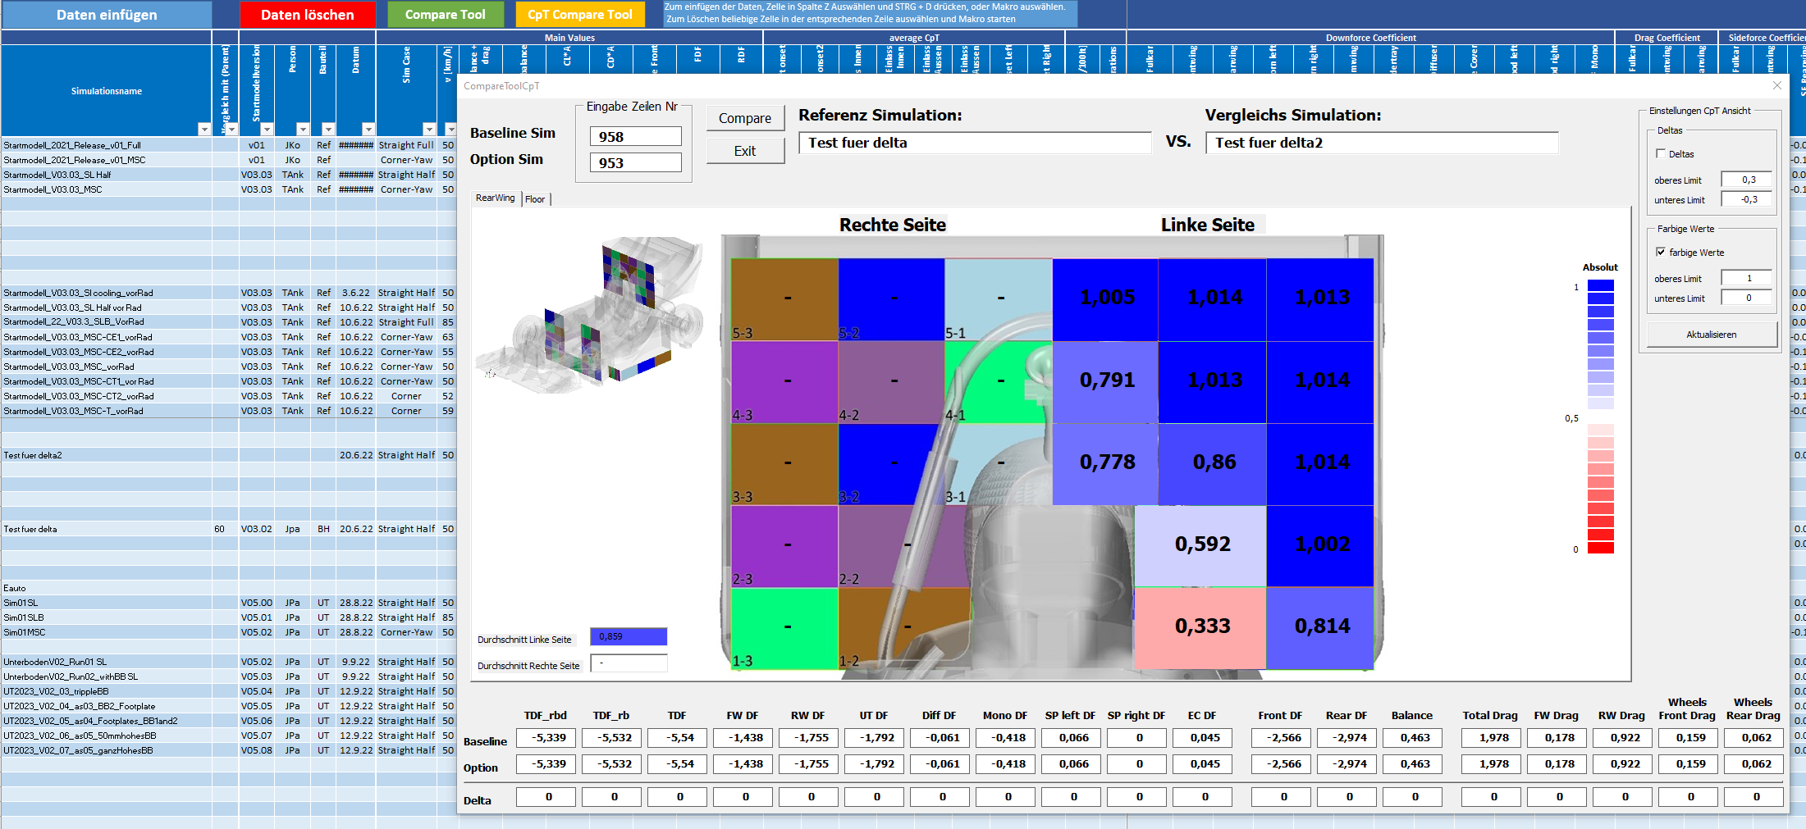
Optimizing THE CFD visualization
Report the simulations and compare them
Use simple techniques to allow a first conclusion

Slide 62
Optimizing THE CFD visualization
Report the simulations and compare them
Use simple techniques to allow a first conclusion
Use delta plots to highlight flow field and pressure deltas
Slice geometry and plot Cp distribution

Slide 63
Optimizing THE CFD visualization
Off-surface data:
Focus on energy content of air (total pressure → CpT)
Use mainly x-slices to understand the flow field
Additionally use static pressure (Cp) and vortex visualization (vorticity, Q-criterion, Lambda2-criterion, Rotex, …)
Velocity vectors
Surface data:
Static pressure
Streamlines
Wall shear stress

Slide 64
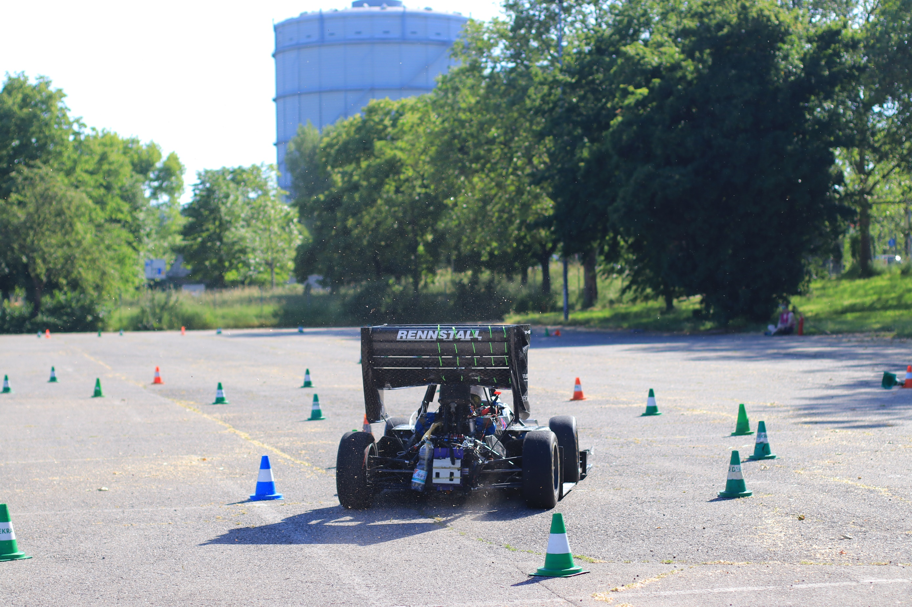
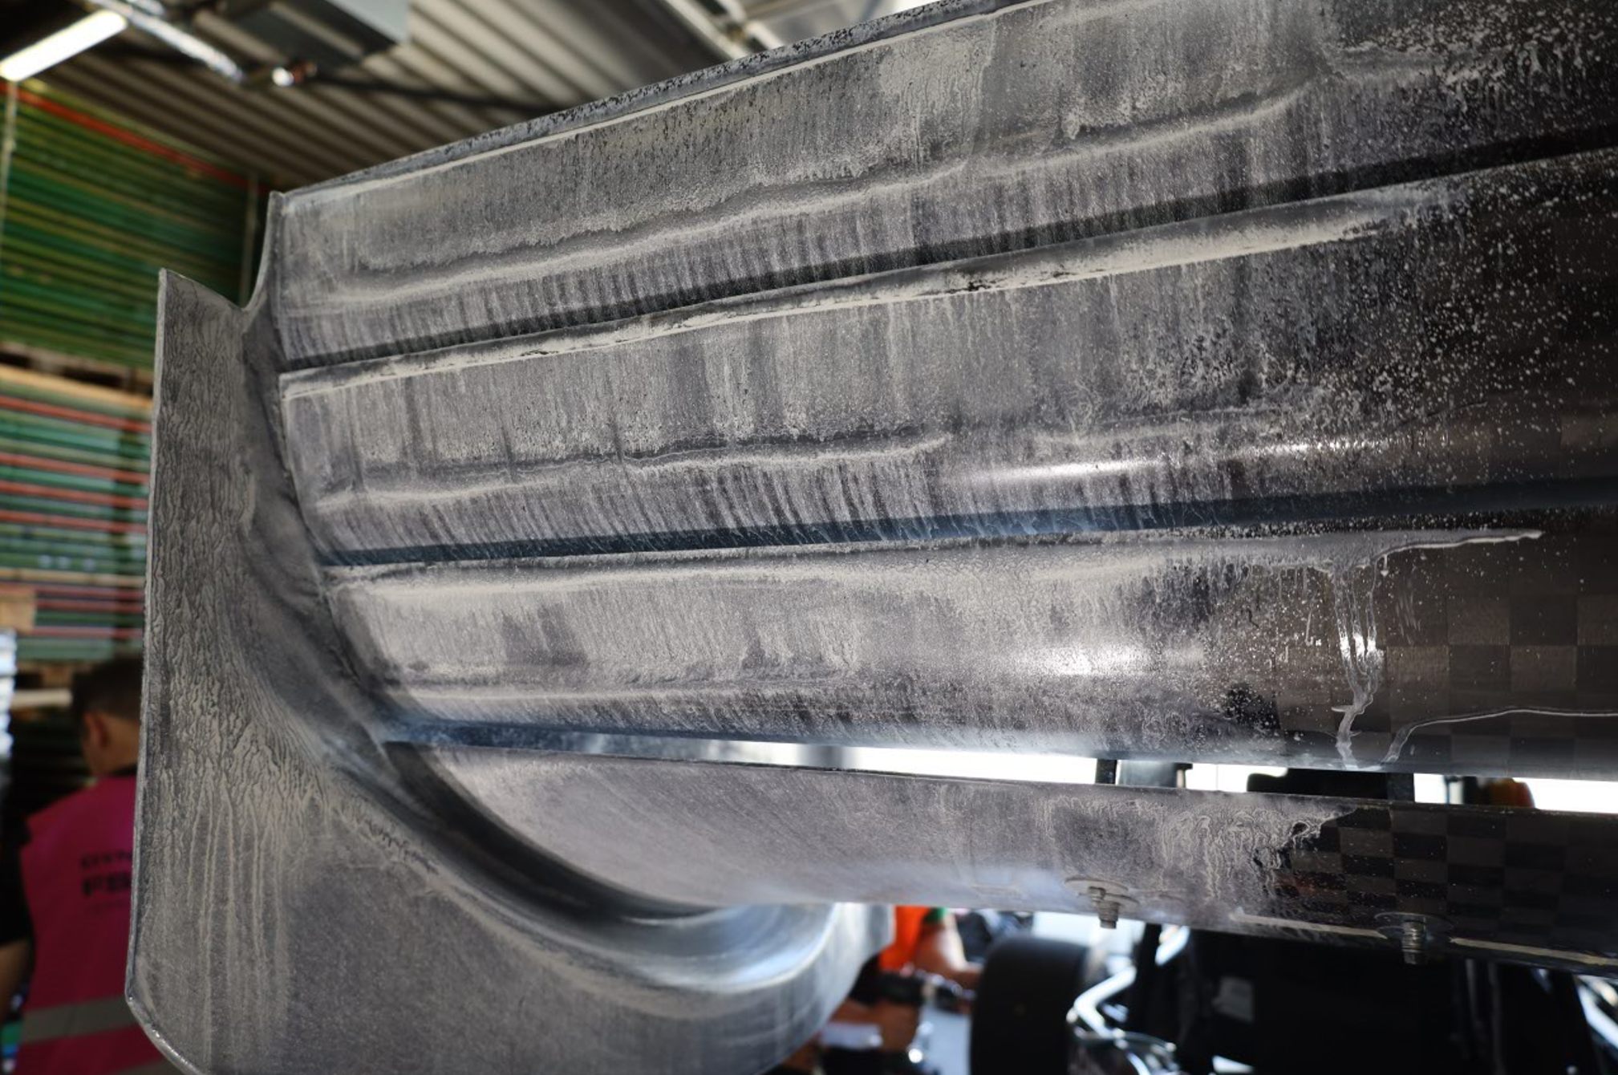
TESTING & VALIDATION
Wool Tufts
Flow Vis paint
Spring travel → downforce
Coasting test → drag
Pressure Tapping
Rake
Greenteam Uni Stuttgart

Slide 65
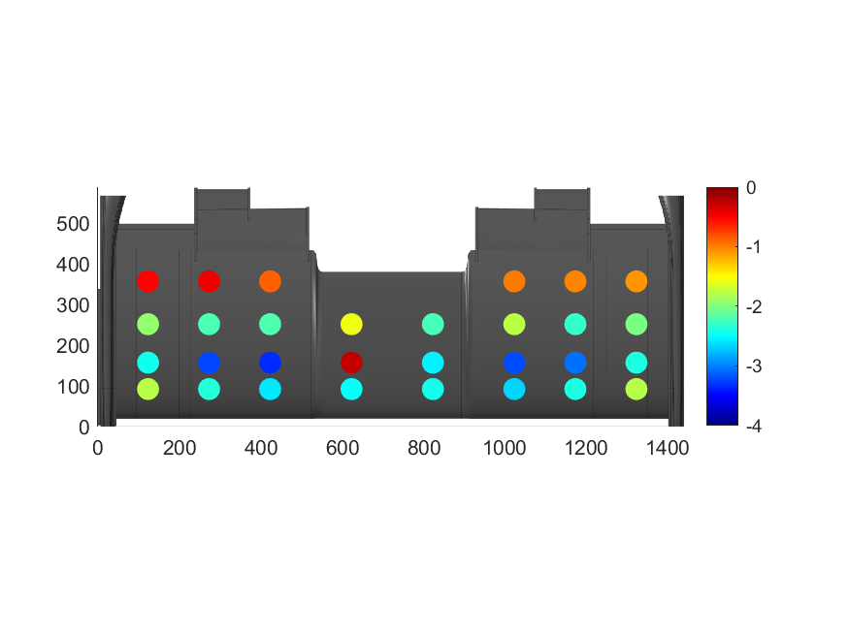
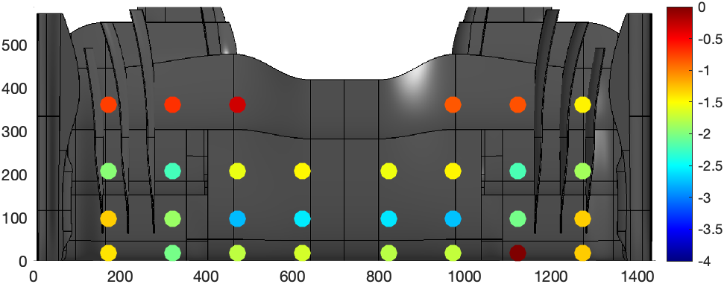
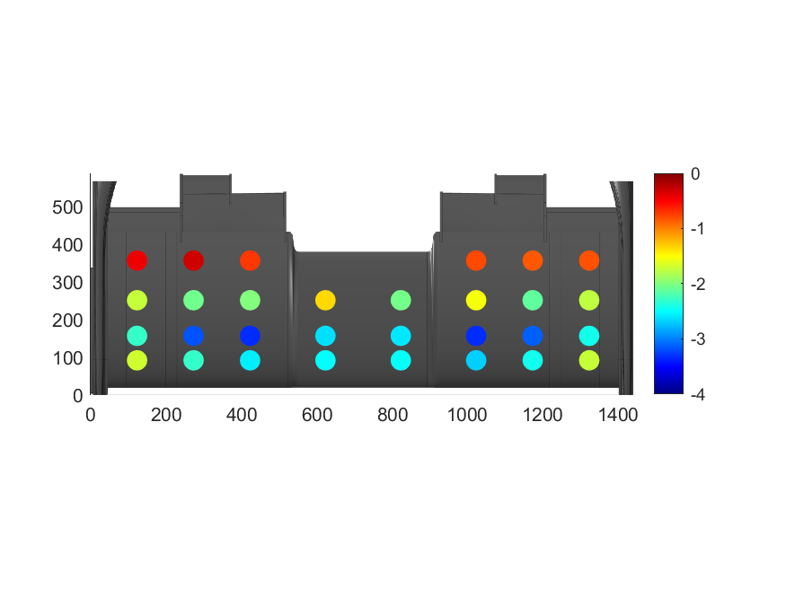
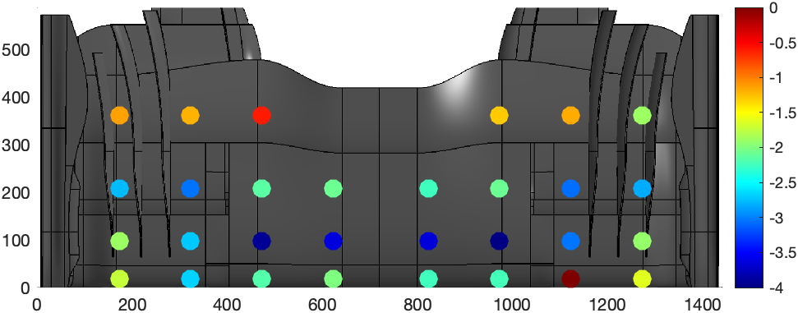
TESTING & VALIDATION
Front wing pressure tappings in straight line
old FW
new FW
40 mm RH
30 mm RH

Slide 66
Common Formula Student mistakes

Slide 67
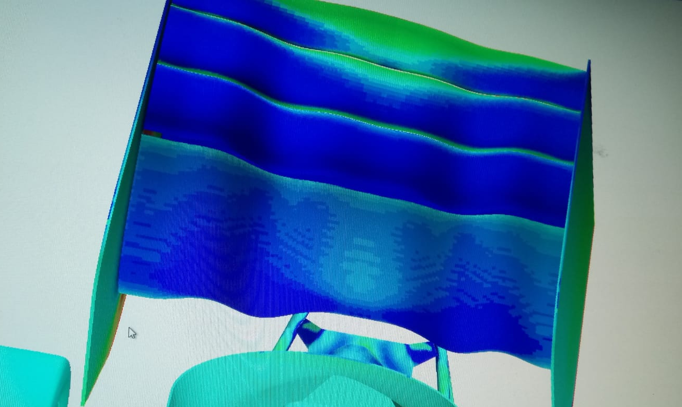
Common Formula Student mistakes
CFD
High wall y⁺ for the whole car
Use high Reynolds approach where you don’t need to fully resolve the boundary layers
Low Reynolds approach only where you really need it (suction surfaces of wings etc.)
low quality CFD simulations (< 20 mio cells for fullcar simulation)
Be aware of possible issues, do not assume you get the right solution
Perform a mesh study
Compare your results with a better resolved flow field
Only refine where it is really necessary
Can you use different mesh settings for developing different areas on the car?
2D simulations
A race car is 3D!
You can not even develop a front wing profile in clean flow in 2D
You can use 2D to understand fundamentals of airfoils etc. but not to develop components for your car
Transient simulations (RANS)
Focus on improving your steady-state simulation first
Transient simulations should use at least DES approach
Use a finer mesh for DES. This still does not give you the real flow field

Slide 68
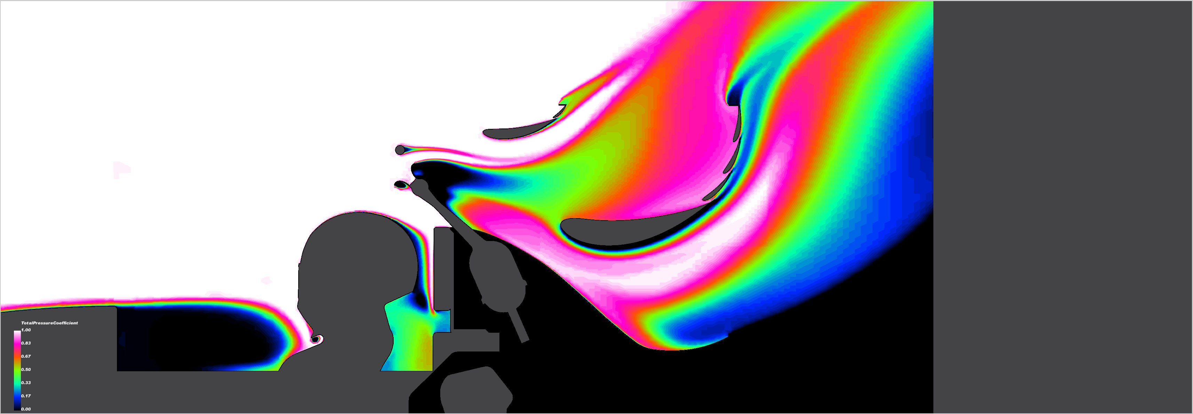
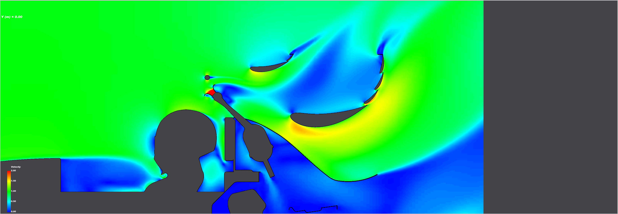
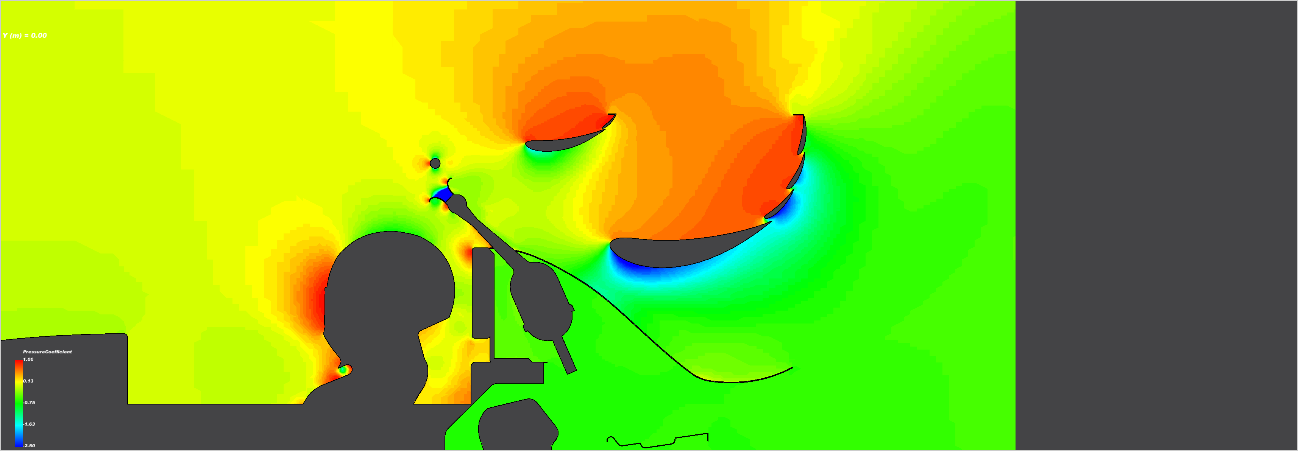
Common Formula Student mistakes
CFD
Validate the simulations
Use at least wool tufts to make sure your wings don’t separate
Wool tufts and flow viz on pressure sides is useless
Validation is not something you only do for the engineering design event
Make the most out of your CFD results
Use the right flow variables for the visualization
Are y-sections always the best?
Total Cp
Velocity
Cp

Slide 69
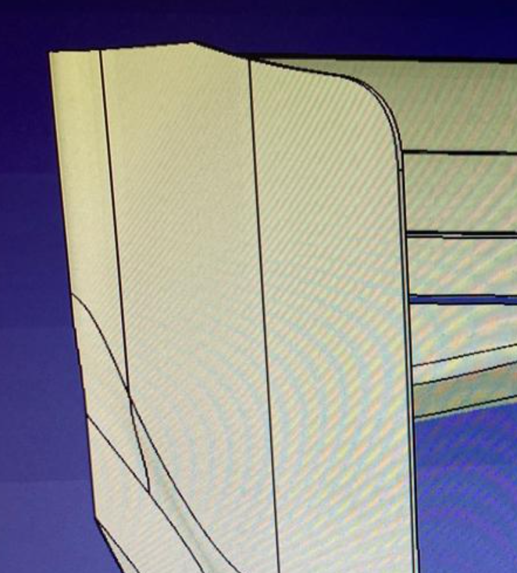
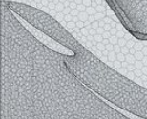

Common Formula Student mistakes
Aero concept
Define your design goals appropriately
Lift/drag target
Aero balance target
Use lap time simulations or experience from previous years
How much do you benefit from your aero?
Do not copy from F1
Do not design the car for straight ahead only
imagine what will happen under yaw if you can not run cornering or yaw simulations
Use wing profiles at leading edges of endplates
Use the right wing profiles
(high lift) airfoils from a online database are not designed for running in a multi element config or in close proximity to the ground
Design your wing cascades properly
Make sure there is a good reason to use more than one element
Pay attention to the slot gaps. While designing them but also in manufacturing
Integrate cooling into the aero package
It is not something for the powertrain or battery guys
Optimize your onset flow and manage the departing flow

Slide 70
Thank you!

